Slide 1
Effect of nutrient management options on productivity and nutritional quality of organically-grown Basmati rice under the long-term experiment (20 years) of Basmati rice-wheat cropping system
DIVISION OF AGRONOMY, ICAR-IARI, NEW DELHI
Dr Y.S. Shivay, Principal Scientist
Division of Agronomy, ICAR-Indian Agricultural Research Institute
New Delhi 110 012
E-mail: ysshivay@hotmail.com
(M): +91-9868337578
4th International Conference on Organic Rice Farming and Production Systems, Sendai, Japan 4–7 September, 2023
‹#›

Slide 2
INTRODUCTION
Rice (Oryza sativa L.)–wheat (Triticum aestivum L.) cropping system (RWCS) is the world's largest agricultural production system occupying around ~10 Mha in India with 85% area falling in Indo-Gangetic plains (Jat et al. 2019).
Farmers face diverse problems in rice production, with issues such as declining factor productivity, nutrient loss, soil organic carbon content, soil salinization, and elevated nitrate levels in well water (Prasad et al. 2017).
The area under aromatic rice is about 2.1 M ha land in India (APEDA, 2019). In this scenario, there is significant scope to expand the area of organic rice in India.
DIVISION OF AGRONOMY, ICAR-IARI, NEW DELHI
4th International Conference on Organic Rice Farming and Production Systems, Sendai, Japan 4–7 September, 2023
‹#›

Slide 3
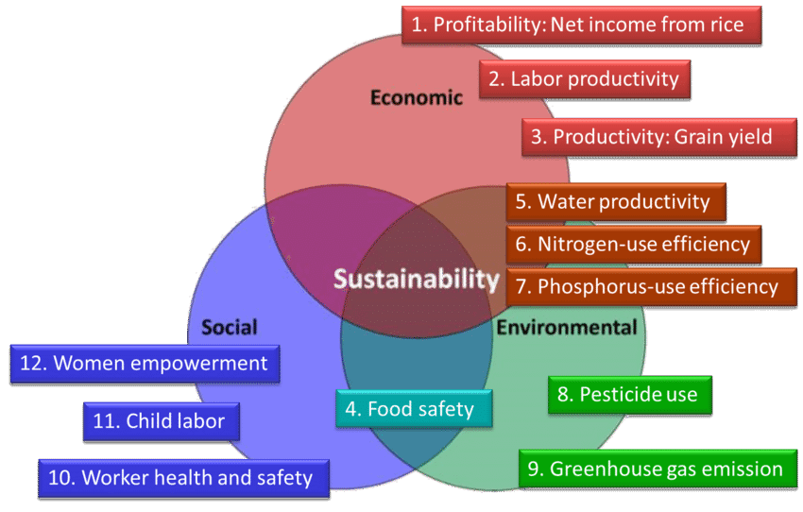
Principles for sustainable rice production as defined by the Sustainable Rice Platform
DIVISION OF AGRONOMY, ICAR-IARI, NEW DELHI
Source: The Sustainable Rice Platform (2017)
4th International Conference on Organic Rice Farming and Production Systems, Sendai, Japan 4–7 September, 2023
‹#›

Slide 4
Why Organic Farming in Rice?
Organic agriculture is a holistic strategy to restore soil fertility, improve the build-up of soil organic matter, and enhance nutrient uptake and concentration in grains.
The inclusion of legumes as green manure in the RWCS has been reported to improve soil physicochemical properties, macro and micronutrient availability in the soil (Dhaliwal et al. 2019)
India has exported 4.558 million tonnes of Basmati rice to the world, worth of 4,787.5 million US $ during the year 2022-23.
Major export destination countries were Saudi Arab, Iran, Iraq, United Arab EMTs, and Yemen Republic, etc. (https://apeda.gov.in/apedawebsite).
DIVISION OF AGRONOMY, ICAR-IARI, NEW DELHI
4th International Conference on Organic Rice Farming and Production Systems, Sendai, Japan 4–7 September, 2023
‹#›

Slide 5
The 4 Principles of Organic farming
DIVISION OF AGRONOMY, ICAR-IARI, NEW DELHI
Source: Global landscapes forum (2023)
4th International Conference on Organic Rice Farming and Production Systems, Sendai, Japan 4–7 September, 2023
‹#›

Slide 6
PERCENTAGE OF AREA UNDER ORGANIC FARMING IN THE TOTAL CULTIVATED AREA IN DIFFERENT COUNTRIES OF THE WORLD
The country with the highest share is Liechtenstein (41.6 percent), followed by Austria (26.5 percent),
DIVISION OF AGRONOMY, ICAR-IARI, NEW DELHI
The First Organic country Estonia share (22.4%), percentage of area under organic farming in the total cultivated area
India, share (2.0%) of the total net sown area under organic farming
Increase of organic agricultural land:
India: 3,59,000 ha (+16%) in 2020
Source: FiBL survey 2022 www.organic-world.net – statistics.fibl.org
4th International Conference on Organic Rice Farming and Production Systems, Sendai, Japan 4–7 September, 2023
‹#›

Slide 7
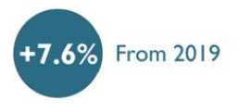
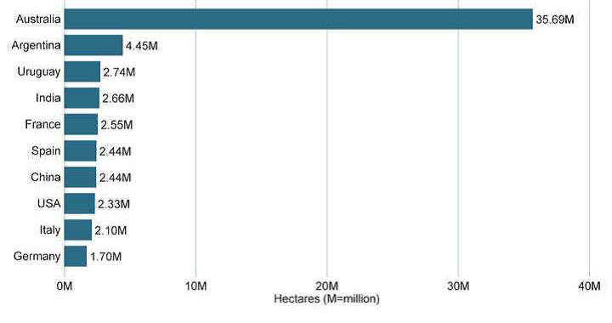
Global Organic Agriculture Trend
Organic Farmers is increasing……
74.9 m ha
3.4 M
+ 7.6%
190
DIVISION OF AGRONOMY, ICAR-IARI, NEW DELHI
Countries with the largest areas of organic agricultural land
1.5 percent of the global agricultural land is organic
Top ten countries with the largest organic agricultural areas represent 78% of the world’s organic agricultural land.
Source: FiBL survey 2022 www.organic-world.net – statistics.fibl.org
4th International Conference on Organic Rice Farming and Production Systems, Sendai, Japan 4–7 September, 2023
‹#›

Slide 8
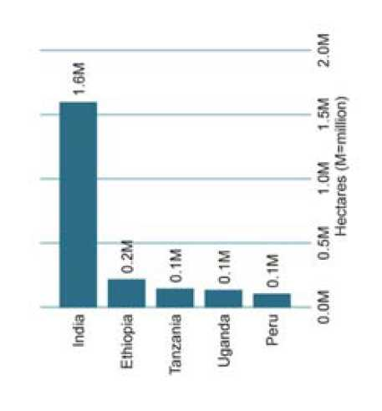
Organic Producers Trend during 2020
1.81 M
in Asia
+7.6% growth
since 2019
World 3.4 million producers
The country with organic producers is India, followed by Ethiopia and Tanzania
More than 90% of the producers are in Asia, Africa, and Europe
There has been an increase in the number of producers by 2,40,000 or 7.6% btw 2019-20
DIVISION OF AGRONOMY, ICAR-IARI, NEW DELHI
Development of the number of organic
producers 1999-2019
Source: FiBL survey 2022 www.organic-world.net – statistics.fibl.org
4th International Conference on Organic Rice Farming and Production Systems, Sendai, Japan 4–7 September, 2023
‹#›

Slide 9
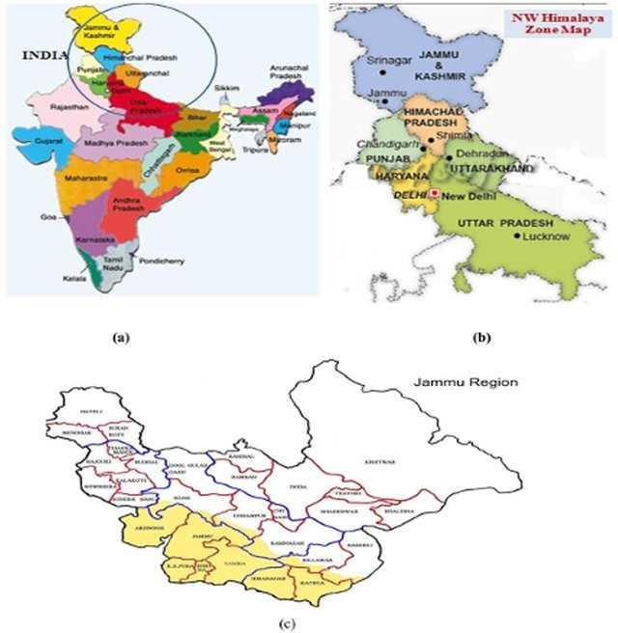
The areas of Basmati rice production in India: Punjab, Haryana, Delhi, Uttarakhand, Himachal Pradesh, J & K and western Uttar Pradesh
DIVISION OF AGRONOMY, ICAR-IARI, NEW DELHI
Considering the importance of Basmati rice as a major export commodity and as a safe food with high commercial value in Indian and International markets
We hypothesized that organic Basmati rice production with locally available organic manures such as FYM, Sesbania, and Blue Green Algae (BGA) could be a strategy for future rice production with this experiment which was initiated in Year 2003
4th International Conference on Organic Rice Farming and Production Systems, Sendai, Japan 4–7 September, 2023
‹#›

Slide 10
TREATMENT DETAILS
Title of Experiment
Effect of nutrient management options on productivity and nutritional quality of organically-grown Basmati rice under the long-term experiment (20 years) of Basmati rice-wheat cropping system
Treatments
T₁: Control
T₂: FYM @ 10 t ha^{–1} (farm yard manure)
T₃: Sesbania green manuring (SGM)
T₄: SGM + BGA (Blue green algae)
T₅: SGM + FYM
T₆: SGM + FYM + BGA
Experimental design | Randomized Block Design
Replications | 3
Plot size | 4.8 m x 4.8 m = 23.04 m²
Rice variety | Pusa Basmati 1
DIVISION OF AGRONOMY, ICAR-IARI, NEW DELHI
Location of the Experiment : ICAR-Indian Agricultural Research Institute, New Delhi
4th International Conference on Organic Rice Farming and Production Systems, Sendai, Japan 4–7 September, 2023
‹#›

Slide 11
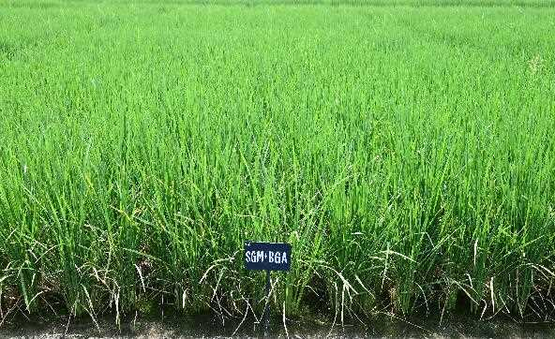
OBJECTIVES
To study the effect of different combinations of organic manures on the yield and grain quality of rice
To assess the impact of different combinations of organic manures on soil health under organic farming in rice
To find out the most economic combination of organic manures and biofertilizers for organic farming of rice
DIVISION OF AGRONOMY, ICAR-IARI, NEW DELHI
HISTORY OF THE EXPERIMENT
The present experiment was initiated in year 2003 and continuing…
Rice-Wheat cropping system is been followed till date
4th International Conference on Organic Rice Farming and Production Systems, Sendai, Japan 4–7 September, 2023
‹#›

Slide 12
Table 1. Effect of organic nutrient management options on the productivity of Basmati rice under the long-term experiment (20 years)
Treatment | Grain yield (t ha^{–1}) | Straw yield (t ha^{–1}) | Biological yield (t ha^{–1}) | Harvest Index (%)
Control | 2.23^{c} | 8.42^{d} | 10.65^{d} | 20.9^{b}
FYM @ 10 t/ha | 3.62^{b} | 11.44^{bc} | 15.07^{bc} | 24.1ª
Sesbania green manuring (SGM) | 3.43^{b} | 11.13^{c} | 14.56^{c} | 24.3ª
SGM + Blue-green algae (BGA) | 3.63^{b} | 11.38^{bc} | 15.01^{bc} | 24.2ª
SGM + FYM | 4.16ª | 12.35^{ab} | 16.51^{ab} | 25.2ª
SGM + FYM + BGA | 4.32ª | 12.58ª | 16.90ª | 25.6ª
 | 0.097 | 0.206 | 0.348 | 0.456
LSD (P =0 .05) | 0.310 | 0.658 | 1.118 | 1.654
DIVISION OF AGRONOMY, ICAR-IARI, NEW DELHI
4th International Conference on Organic Rice Farming and Production Systems, Sendai, Japan 4–7 September, 2023
‹#›

Slide 13
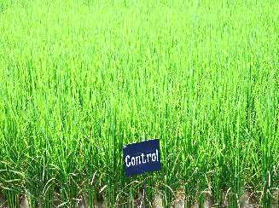
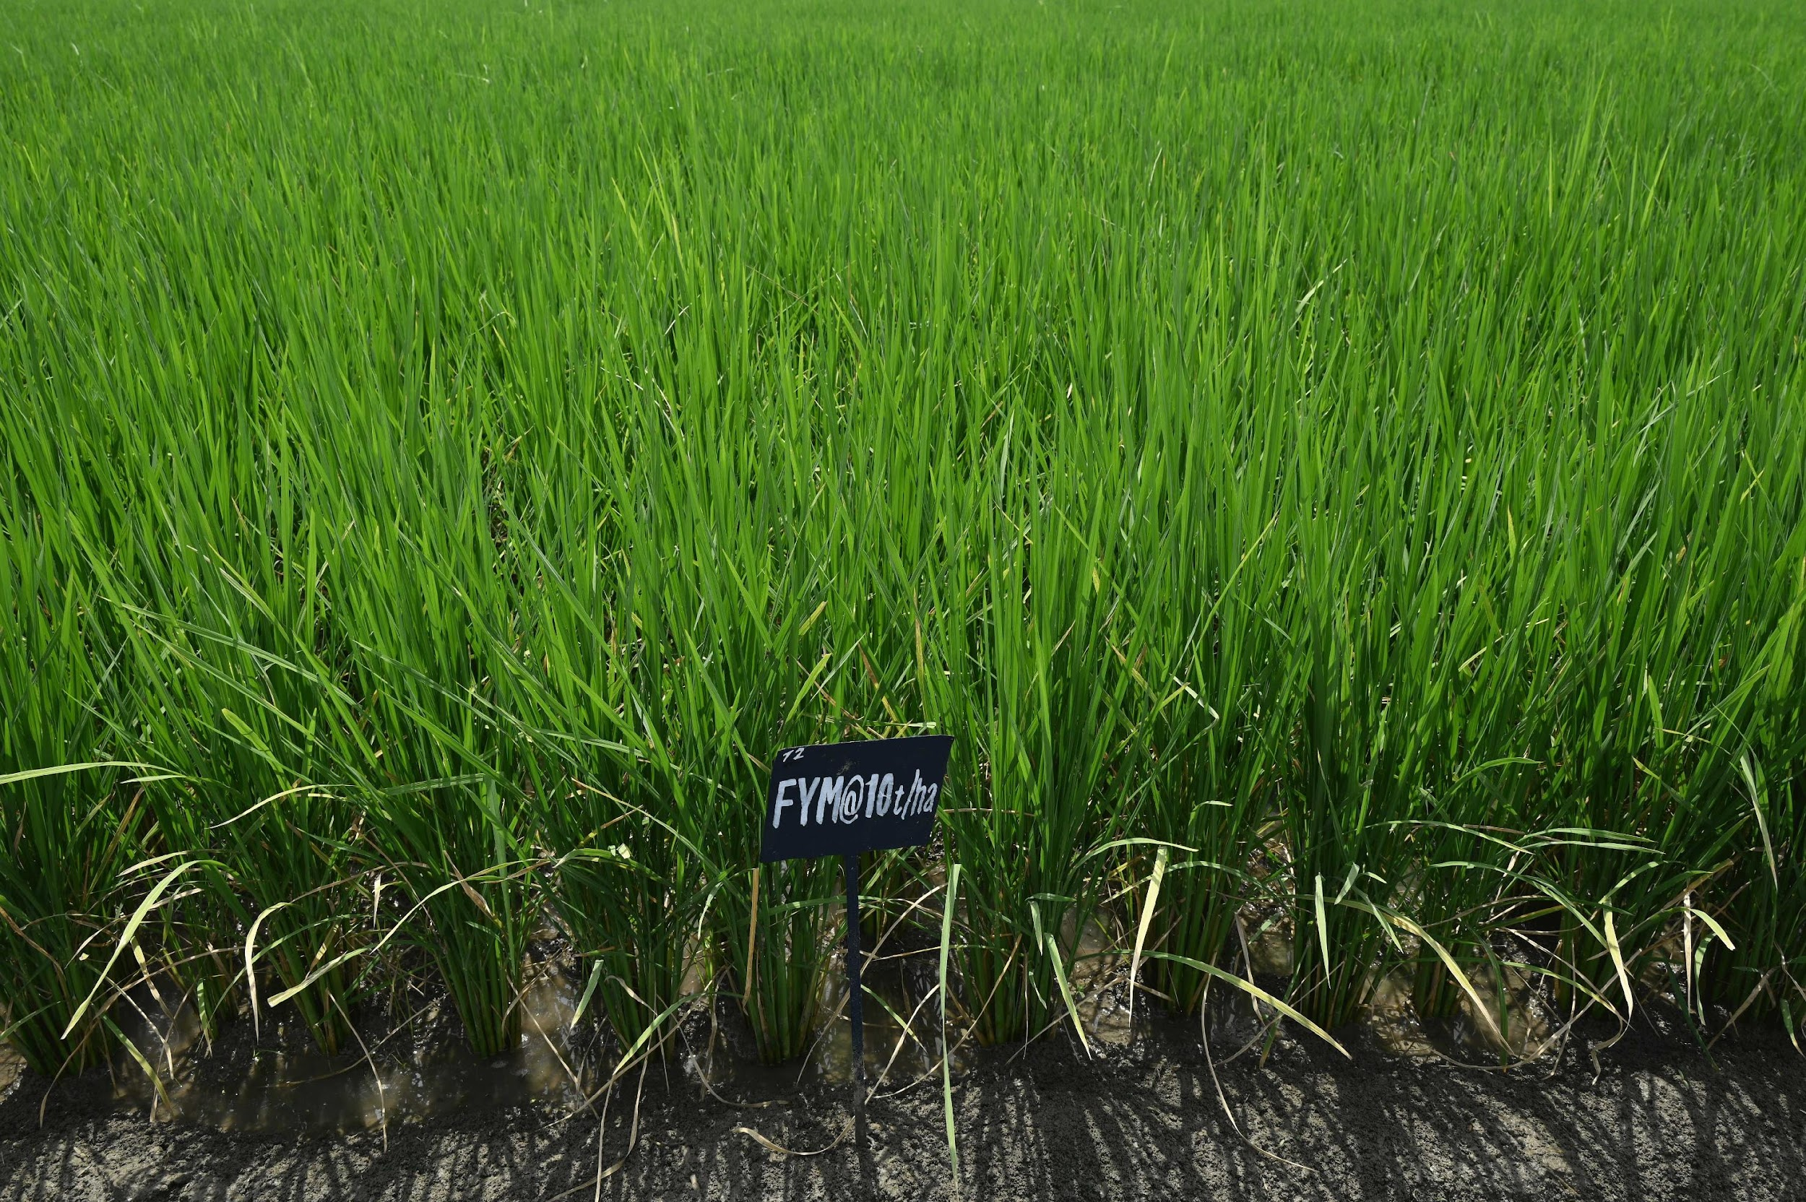
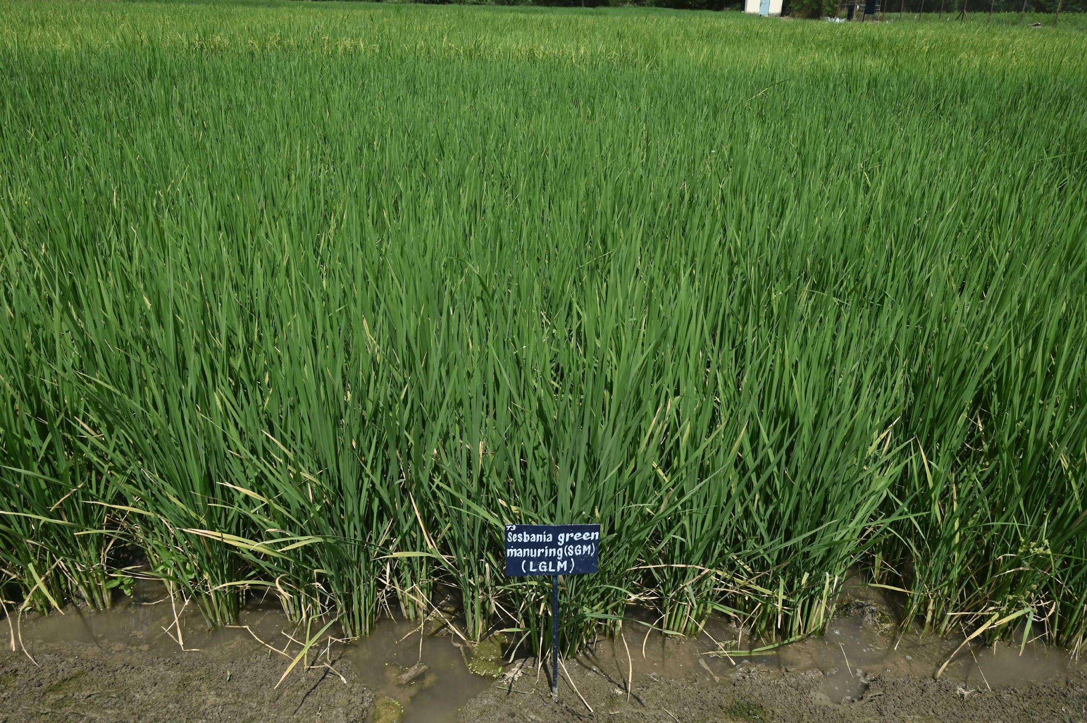
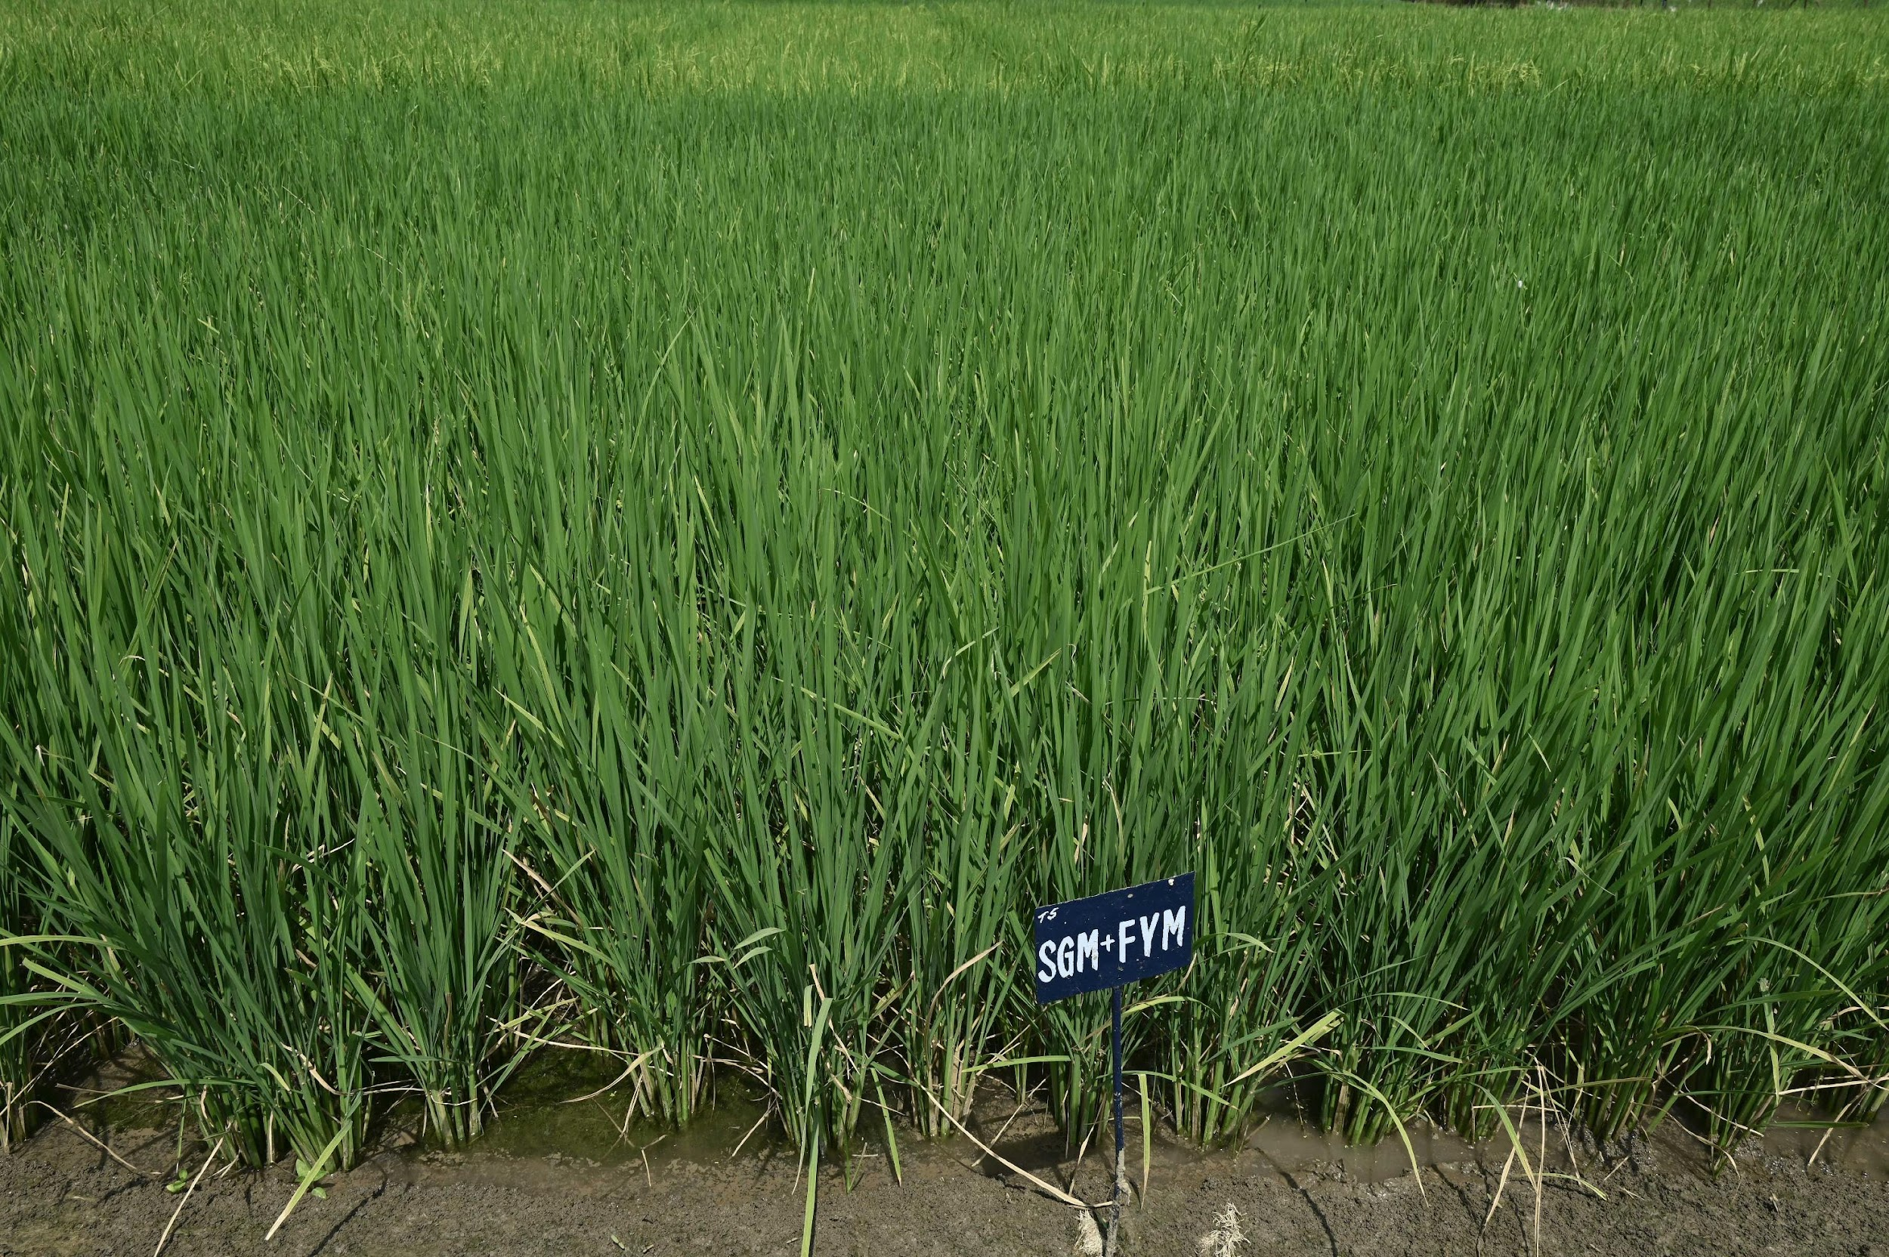
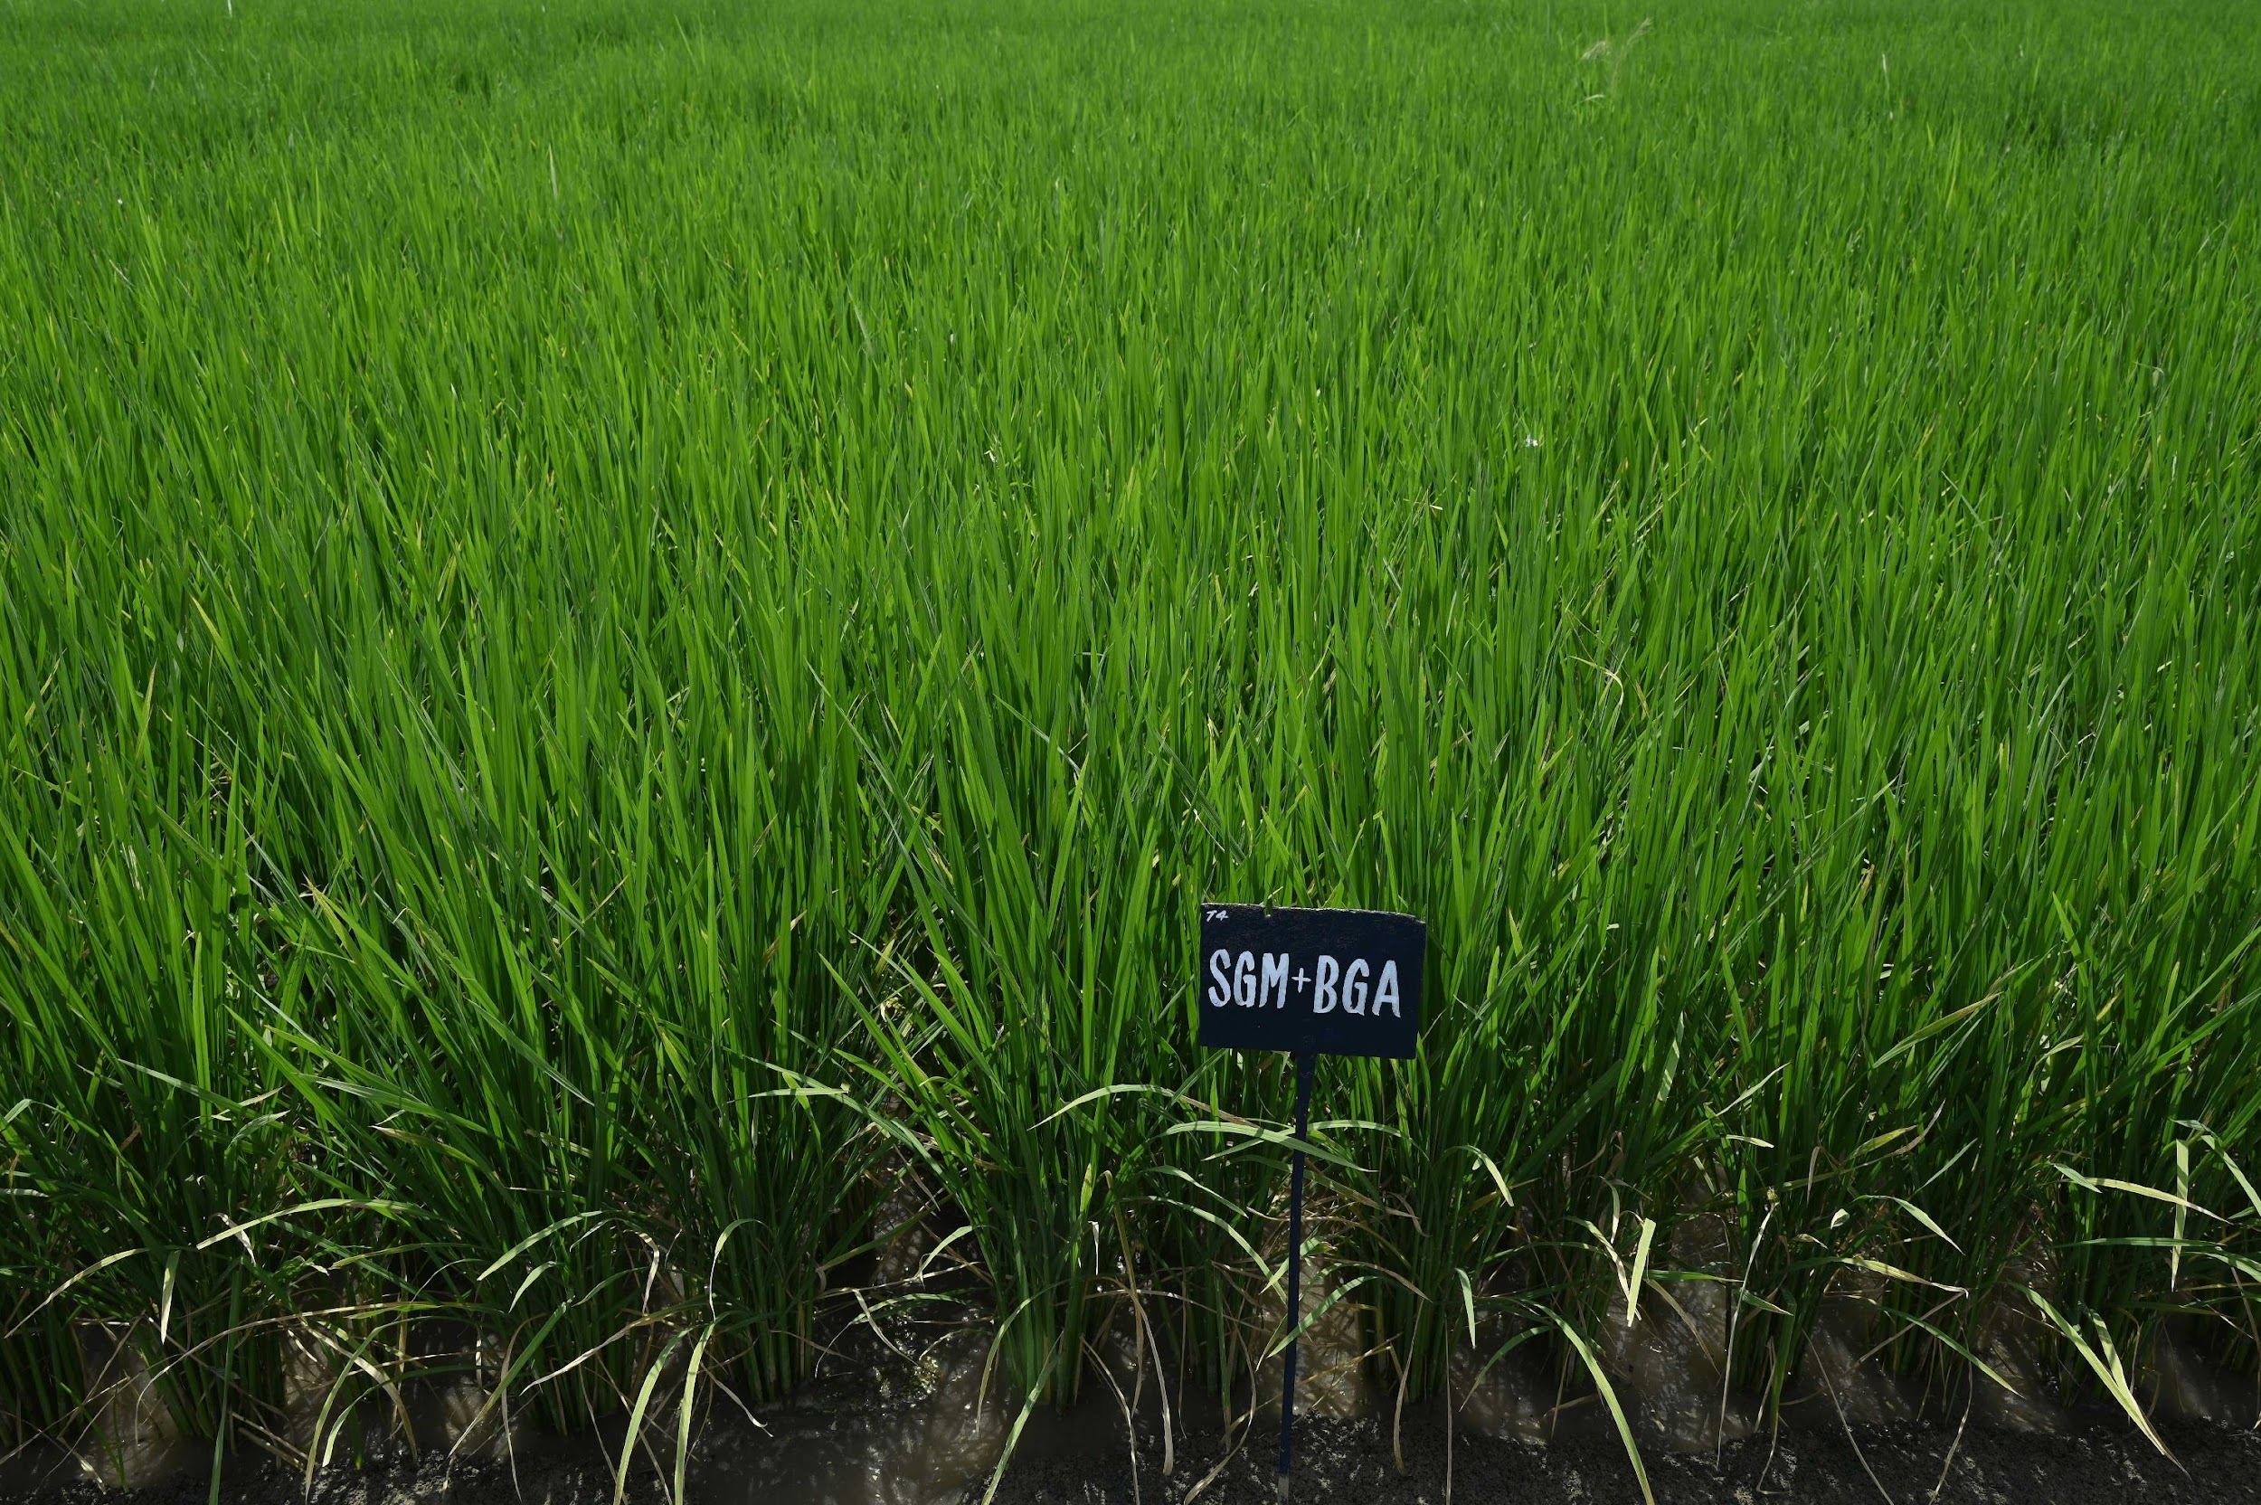
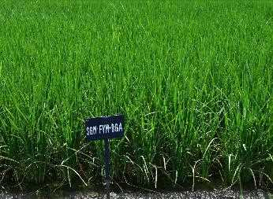
Field experiment treatments photos
DIVISION OF AGRONOMY, ICAR-IARI, NEW DELHI
4th International Conference on Organic Rice Farming and Production Systems, Sendai, Japan 4–7 September, 2023
‹#›

Slide 14
Figure 1. Effect of nutrient management options on zinc and nitrogen content of organically-grown Basmati rice under long-term experiment (20 years)
DIVISION OF AGRONOMY, ICAR-IARI, NEW DELHI
Application of SGM + FYM + BGA recorded the highest nitrogen content in the grain being 14.4% higher, similarly 20.9% higher zinc concentration in rice grain over the control.
4th International Conference on Organic Rice Farming and Production Systems, Sendai, Japan 4–7 September, 2023
‹#›

Slide 15
Table 2. Effect of organic nutrient management options on nitrogen and zinc uptake in grain of Basmati rice under the long-term experiment (20 years)
Treatment | Nitrogen uptake in grain (kg ha⁻¹) | Zinc uptake in grain (g Zn ha⁻¹)
Control | 24.24e | 57.31e
FYM @ 10 t/ha | 43.08^{cd} | 109.32^{d}
Sesbania green manuring (SGM) | 41.85^{d} | 107.70^{d}
SGM + Blue-green algae (BGA) | 44.65^{c} | 114.71^{c}
SGM + FYM | 52.42^{b} | 133.12^{b}
SGM + FYM+ BGA | 54.86ª | 140.40ª
 | 0.99 | 1.38
LSD (P =0 .05) | 3.14 | 4.36
DIVISION OF AGRONOMY, ICAR-IARI, NEW DELHI
4th International Conference on Organic Rice Farming and Production Systems, Sendai, Japan 4–7 September, 2023
‹#›

Slide 16
Figure 2. Effect of nutrient management options on crude protein (%) content of organically-grown Basmati rice under long-term experiment (20 years)
DIVISION OF AGRONOMY, ICAR-IARI, NEW DELHI
4th International Conference on Organic Rice Farming and Production Systems, Sendai, Japan 4–7 September, 2023
‹#›

Slide 17
Table 3. Effect of organic nutrient management options on the soil biomass carbon and soil dehydrogenase activity of Basmati rice under the long-term experiment (20 years)
Treatment | Soil microbial biomass carbon (μg g^{–1} soil) | Soil dehydrogenase activity (μg TPF g^{–1} soil h^{–1})
Control | 227.2e | 17.9^{d}
FYM @ 10 t/ha | 372.3^{d} | 25.4^{b}
Sesbania green manuring (SGM) | 430.1^{c} | 21.2^{c}
SGM + Blue-green algae (BGA) | 448.2^{b} | 26.0^{b}
SGM + FYM | 471.2ª | 26.1^{b}
SGM + FYM + BGA | 470.4ª | 33.3ª
 | 6.55 | 0.79
LSD (P =0 .05) | 19.2 | 2.31
DIVISION OF AGRONOMY, ICAR-IARI, NEW DELHI
4th International Conference on Organic Rice Farming and Production Systems, Sendai, Japan 4–7 September, 2023
‹#›

Slide 18
Figure 3. Effect of nutrient management options on total organic carbon (TOC) of organically-grown Basmati rice under long-term experiment (20 years)
DIVISION OF AGRONOMY, ICAR-IARI, NEW DELHI
4th International Conference on Organic Rice Farming and Production Systems, Sendai, Japan 4–7 September, 2023
‹#›

Slide 19
Table 4. Effect of organic nutrient management options on economic returns of Basmati rice under the long-term experiment (20 years)
Treatment | Cost of cultivation (US $ ha^{–1}) | Gross returns (US $ ha^{–1}) | Net returns (US $ ha^{–1})
Control | 281.2 | 927.7 | 646.6
FYM @ 10 t/ha | 505.1 | 1506.0 | 1001.0
Sesbania green manuring (SGM) | 329.4 | 1427.0 | 1097.6
SGM + Blue-green algae (BGA) | 332.5 | 1510.2 | 1177.7
SGM + FYM | 553.3 | 1730.7 | 1177.4
SGM + FYM+ BGA | 556.4 | 1797.3 | 1240.8
S/NS (p=0.05) | – | S | S
DIVISION OF AGRONOMY, ICAR-IARI, NEW DELHI
4th International Conference on Organic Rice Farming and Production Systems, Sendai, Japan 4–7 September, 2023
‹#›

Slide 20
Figure 4. Effect of organic nutrient management options on economic returns of Basmati rice under the long-term experiment (20 years)
DIVISION OF AGRONOMY, ICAR-IARI, NEW DELHI
4th International Conference on Organic Rice Farming and Production Systems, Sendai, Japan 4–7 September, 2023
‹#›

Slide 21
ORGANIC POLICY IN INDIA & RECOMMENDATIONS
From niche to mainstream: An agenda for organic marketing of Basmati rice
Intensive campaign
Organic Mela’s
State–wide awareness programmes on the advantages of organic produce
Workshops and seminars for consumers, teachers, traders, farmers, government officials
Channels for marketing organic produce
Direct marketing/linkages by farmer’s groups with end-user institutions
Existing vegetable, fruit, and grocery vendors
Organic farm produce outlets
The tourism industry sources organic produce
Availability of quality organic manure to the farmers
Crop rotation, tree crops, cover crops, leguminous crops, green manure
Link organic municipal solid waste to farms –> organic matter recycling
Ensure farm inputs for organic farming
Ensure markets for good quality input materials at reasonable price
Training for local resource persons
DIVISION OF AGRONOMY, ICAR-IARI, NEW DELHI
4th International Conference on Organic Rice Farming and Production Systems, Sendai, Japan 4–7 September, 2023
‹#›

Slide 22
ORGANIC POLICY IN INDIA & RECOMMENDATIONS
From niche to mainstream: An agenda for organic marketing of Basmati rice
Encourage the use of organic farm produce in the food industry
develop a simple certification process
To increase supply, producers need to be confident about the long-term future of the market
Price of the organic products is about 20–30% higher than conventional products
Provide financial incentives for promoting organic farming
Interest-free loans to especially small and marginal farmers
Assistance during the conversion period
Introduce organic farming in educational institutions
Introduce organic farming in educational institutions through academic inputs Integrate of various departments, local self-governments and
organizations
Forward contracting and price policy
DIVISION OF AGRONOMY, ICAR-IARI, NEW DELHI
4th International Conference on Organic Rice Farming and Production Systems, Sendai, Japan 4–7 September, 2023
‹#›

Slide 23
SUMMARY
Based on the long-term study of organic nutrient management options for Basmati rice it can be concluded that the application of Sesbania green manuring (SGM) + FYM (10 t ha^{–1}) + BGA is the best option to achieve the highest productivity and nutritional quality of organically grown Basmati rice
It was also noticed that, in the organic cultivation of basmati rice-wheat cropping system, through the application of bio-fertilizers nearly 25% quantity of organic manures can be reduced without affecting the crop yields.
The use of organic sources improved the soil physicochemical properties, SOC, and availability of nutrients which in turn increased the grain yield, macro and micronutrient content in grains and their uptake by Basmati rice
DIVISION OF AGRONOMY, ICAR-IARI, NEW DELHI
4th International Conference on Organic Rice Farming and Production Systems, Sendai, Japan 4–7 September, 2023
‹#›

Slide 24
CONCLUSION
Organic agriculture offers the most sustainable solution for developing the agriculture sector and provides food security with the least negative impacts on the environment.
Strong policy is required for the overall framework of the systems approach
Coordination of research, extension, and farmers to encourage farmers’ participatory research and to educate the farmers about organic basmati rice production
Subsidy for critical inputs, easy and low-interest credits, and farmers-friendly crop insurance policies can help the farmers to include pulses in basmati rice-wheat with minimum risk and in turn contribute to the well-being of the nation
DIVISION OF AGRONOMY, ICAR-IARI, NEW DELHI
4th International Conference on Organic Rice Farming and Production Systems, Sendai, Japan 4–7 September, 2023
‹#›

Slide 25
Field visit to organic basmati rice farm
DIVISION OF AGRONOMY, ICAR-IARI, NEW DELHI
4th International Conference on Organic Rice Farming and Production Systems, Sendai, Japan 4–7 September, 2023
‹#›

Slide 26
THANK YOU
4th International Conference on Organic Rice Farming and Production Systems, Sendai, Japan 4–7 September, 2023
‹#›

